Slide 1
Road Network Improvement Using Universal Resilience Patterns
Roman Nett

Slide 2
Overview
Previous Work
Motivations
Dataset
Metrics
Methods
Results
Conclusions
Future Work

Slide 3
Previous Work
Universal resilience patterns in complex networks
Jianxi Gao, Baruch Barzel & Albert Barabási
Resilience describes the stability of a network to perturbations

Slide 4
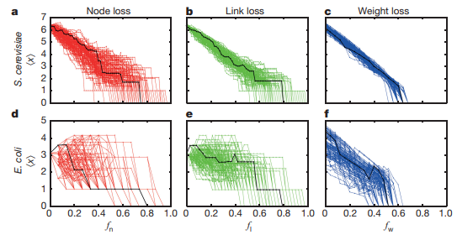
Previous Work
Different networks have different
points of failure
Rarely predictable

Slide 5
Previous Work
Bridged the theoretical gap by deriving a universal resilience function of this form
Obtained by combining multiple 1D single component approximation equations that were used in the past
F(x_{i}) and G(x_{i}, x_{j}) describe the laws that govern the components themselves
A_{ij} represents the interactions (adjacency matrix)

Slide 6
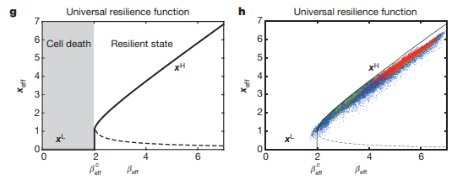
Previous Work
Found the point of bifurcation based solely on the network’s features
Resilience could now be predicted!
Notes:
Red is node loss, green is link loss, blue is weight loss

Slide 7
Previous Work
Topological effects cause by this term
Density + Symmetry*Heterogeneity

Slide 8
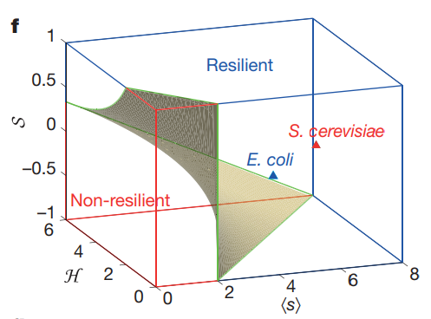
Previous Work
Most resilient with high density, high symmetry, high heterogeneity
Least resilient with low density low symmetry (-1), high heterogeneity
Critical points are not altered

Slide 9
Motivations
Network resilience is nice and all but can improving the resilience improve the general performance of a network?
I have put this to the test by experimenting on a road network

Slide 10
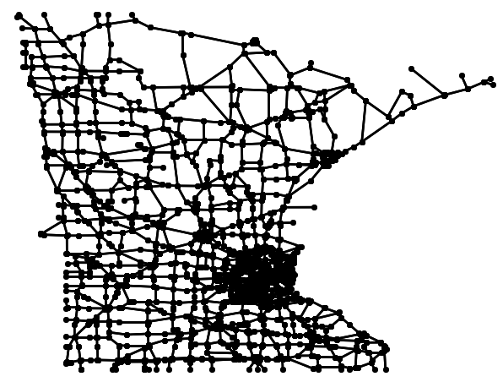
Dataset
Minnesota Road Network
2,642 Nodes
3,303 Edges
Largest Component: 2,640 Nodes

Slide 11
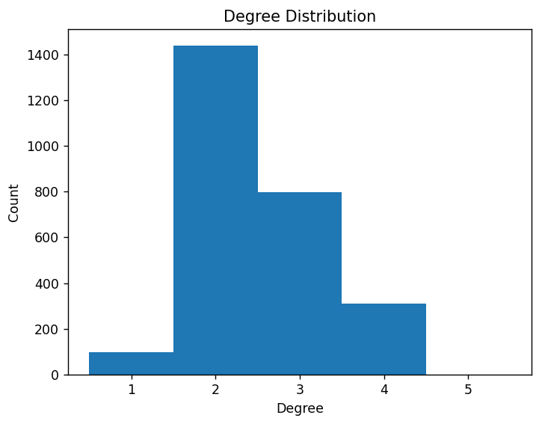
Dataset
Average Degree: 2.500
Min Degree: 1
Max Degree: 5

Slide 12
Metrics
Resilience
Size of the Largest Component
Classic
Network Diameter
Average Path Length
New Metrics
Average Congestion
Car Flow
Previous Work
Density
Heterogeneity
Symmetry

Slide 13
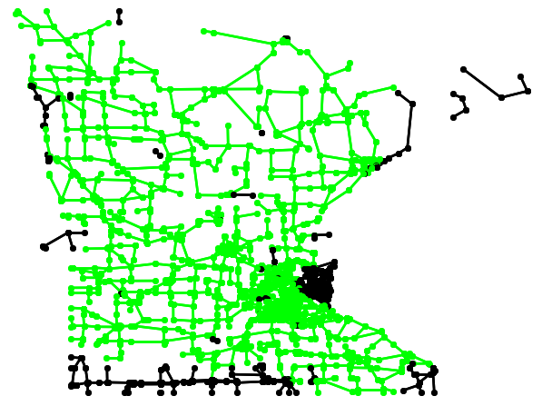
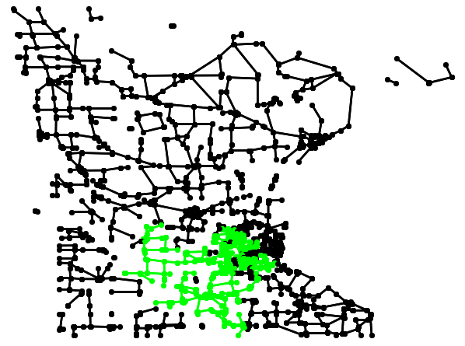
Metrics - Resilience

Slide 14
Metrics - Classic
BFS to determine the shortest path between each pair of nodes

Slide 15
Metrics - Average Congestion
Again using BFS to find the shortest path between each pair of nodes

Slide 16
Metrics - Car Flow
Maximum Flow:
The maximum amount of “stuff” that can travel from a source node to a sink node through
edge capacities
Home Nodes and Destination Nodes
Home Nodes have smaller degree
Destination Nodes have larger degree
~75% Home Nodes and ~25% Destination Nodes

Slide 17
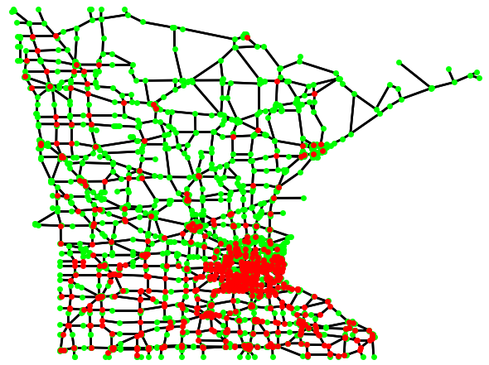
Metrics - Car Flow
75.02% Home Nodes
Edge capacities are inversely proportional to edge costs
scipy.sparse.csgraph.maximum_flow

Slide 18
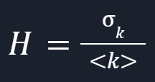
Metrics - Previous Work
Density grows proportionally with average degree
Heterogeneity
Symmetry is always 1 for undirected graphs

Slide 19
Methods - Procedure
Measure all metrics for original network
Perturb network to observe phase shift
Repeat for 10 trials
Partially increase density and perturb
Fully increase density and perturb
Partially increase heterogeneity and perturb
Fully increase heterogeneity and perturb
Fully increase both and perturb
Measure all metrics for fully increased density, heterogeneity, both

Slide 20
Methods - Perturbing
Node removal
Choose a random node
Remove it and all its links from the network
Link removal
Choose a random link
Remove it from the network

Slide 21
Methods - Increasing Density
Add more triangles to the network
Choose a random node
Add a link to one of its neighbor’s neighbors
B
A
C

Slide 22
Methods - Increasing Heterogeneity
Goal is to have large hubs with lots of small degree nodes
Choose random node
If it has degree above three: create a triangle with a neighbor’s neighbor
If it has degree three or below:
Remove an edge
Connect to the closest hub
A
B

Slide 23
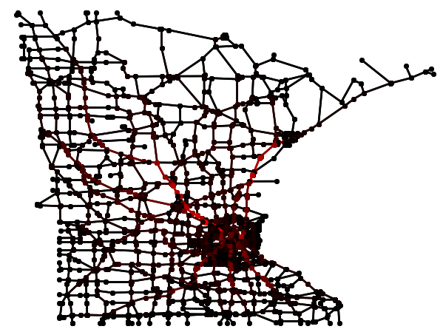
Results - Initial Metrics
Average Congestion | 112,576 ~3.23%
Max Congestion | 948,438 ~27.23%
Car Flow | 51,626
Diameter | 902
Average Distance | 253
Density | 2.500
Heterogeneity | 0.299

Slide 24
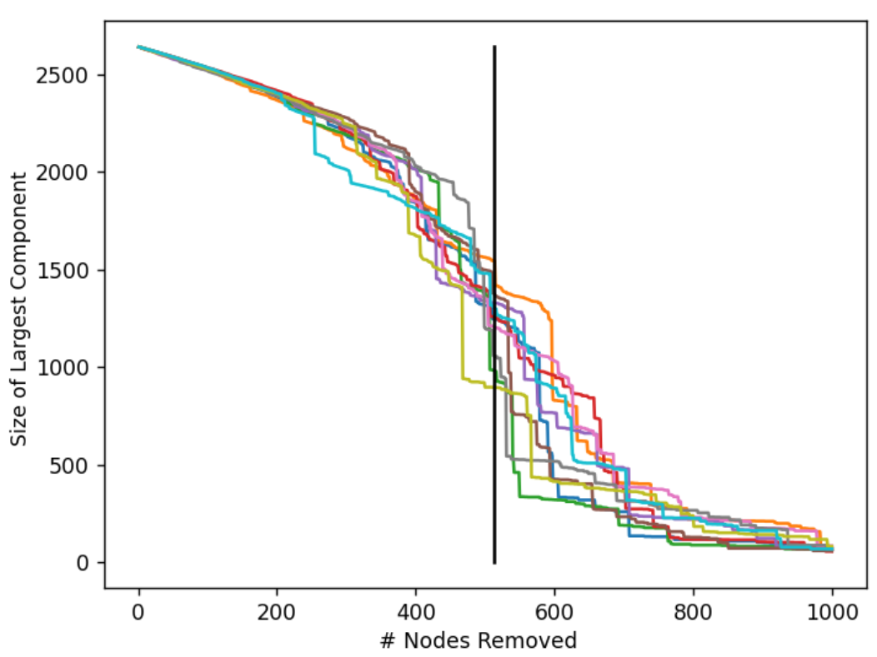
Results - Node Removal
Initial Network
Average of 512.6 nodes

Slide 25
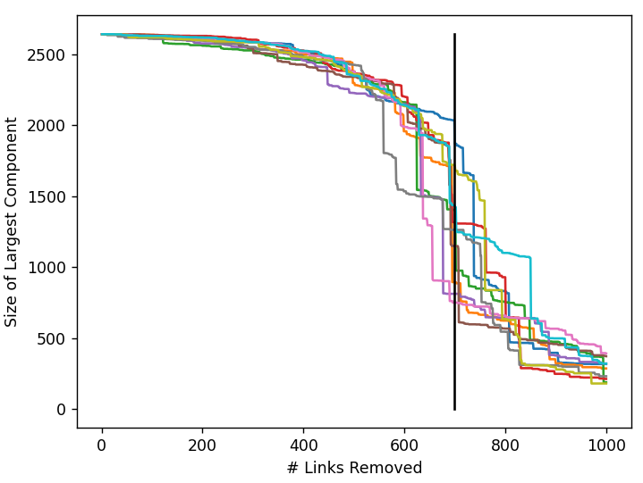
Results - Link Removal
Initial Network
Average of 698.5 links

Slide 26
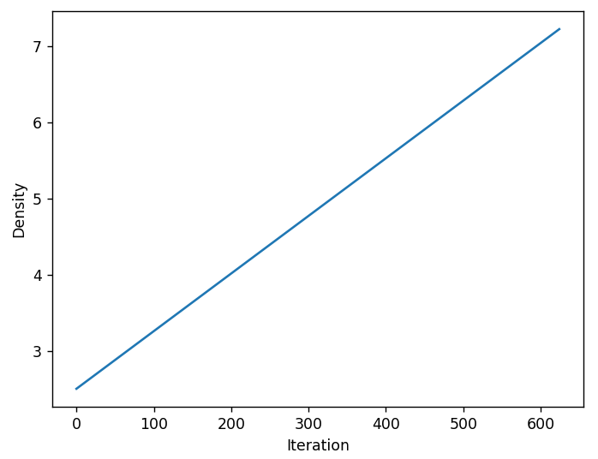
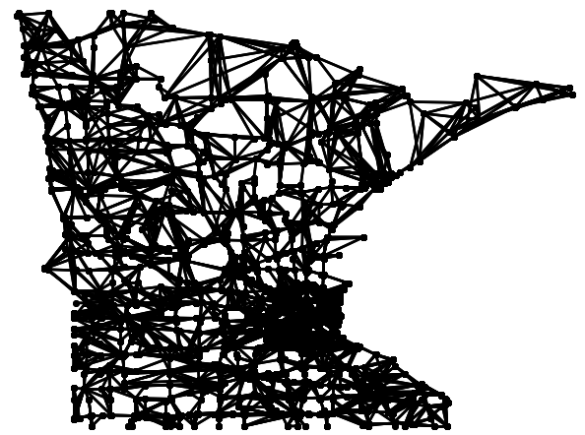
Results - Density Increase

Slide 27
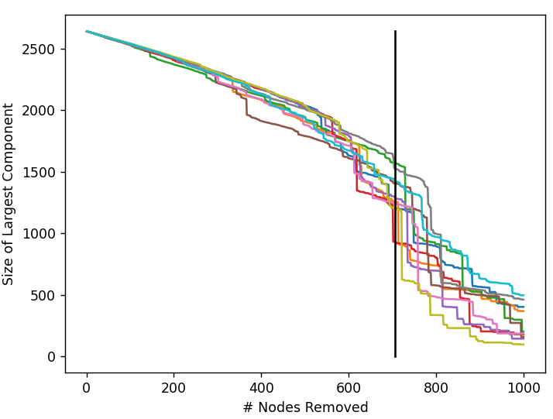
Results - Partial Density Increase
New Density of ~4.866
Average of 705.5 nodes

Slide 28
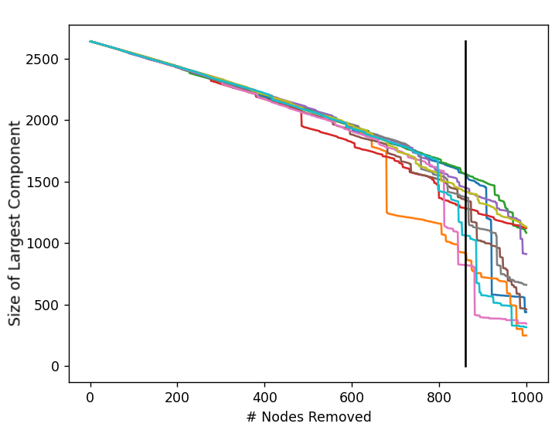
Results - Full Density Increase
New Density of ~7.232
Average of 860.8 nodes

Slide 29
Results - Combined

Slide 30
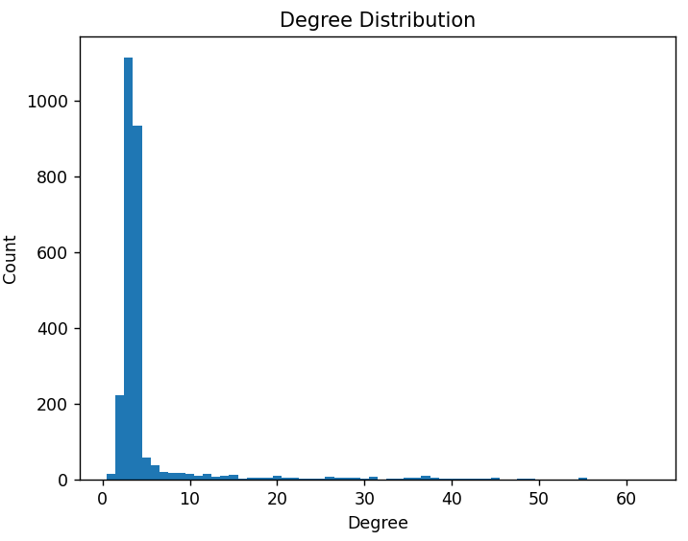
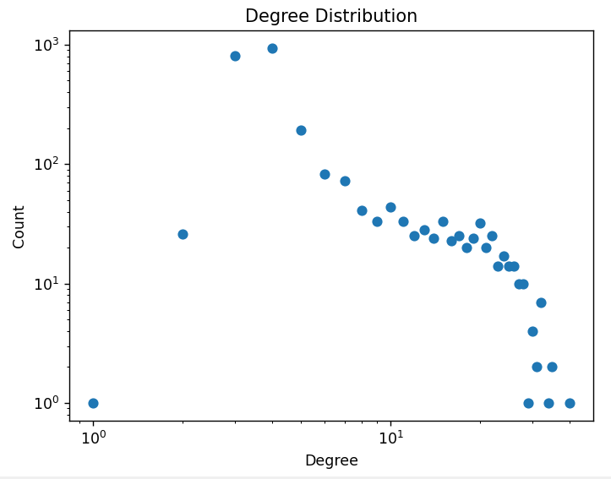
Results - Heterogeneity Increase

Slide 31
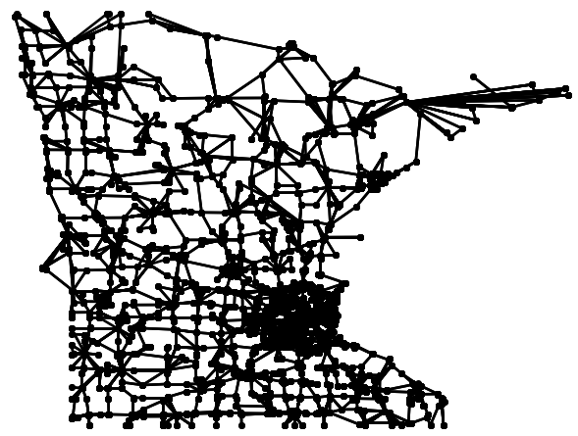
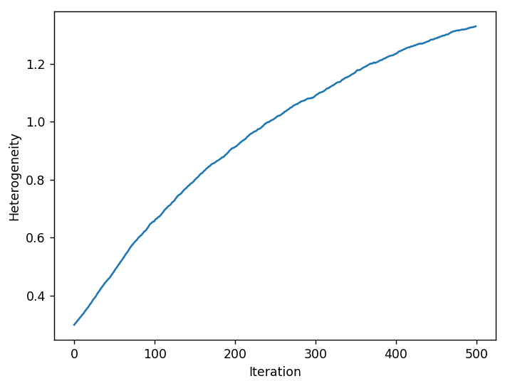
Results - Heterogeneity Increase

Slide 32
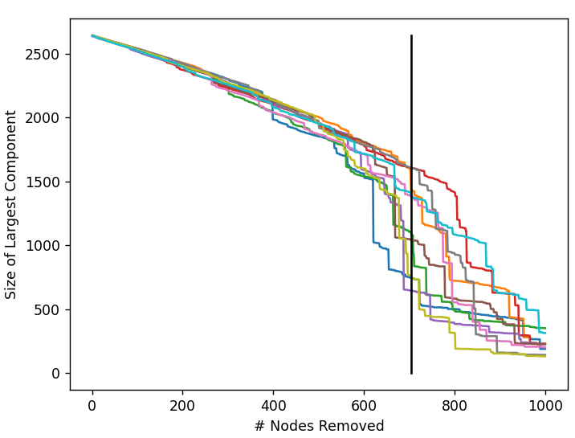
Results - Partial Heterogeneity Increase
New H of ~1.022
Average of 705.0 nodes

Slide 33
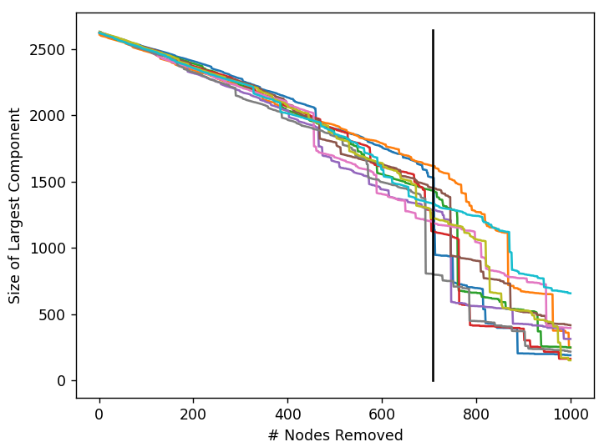
Results - Full Heterogeneity Increase
New H of ~1.324
Average of 708.0 nodes

Slide 34
Results - Combined

Slide 35
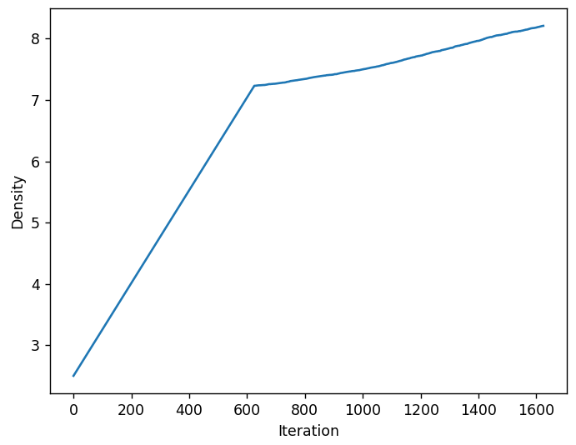
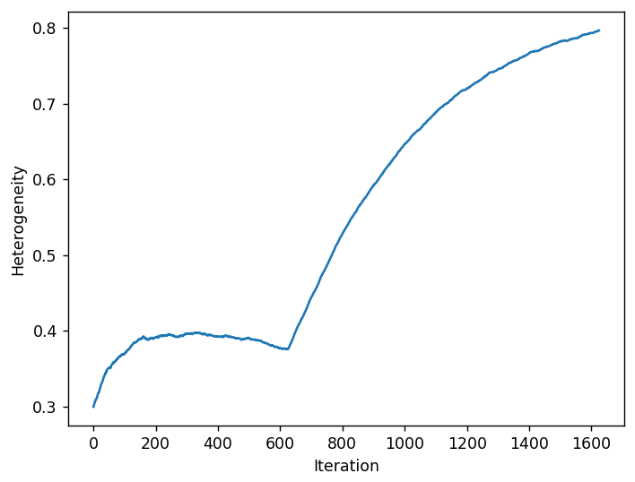
Results - Both Increase

Slide 36
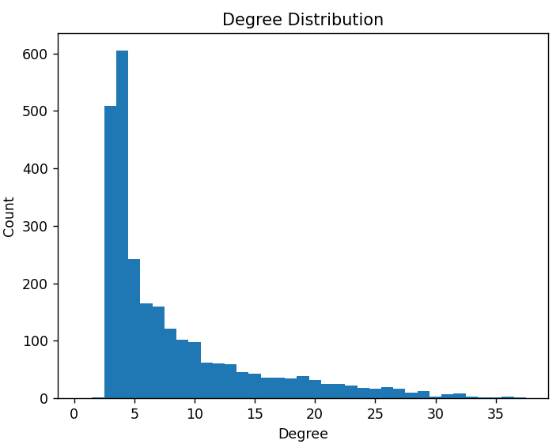
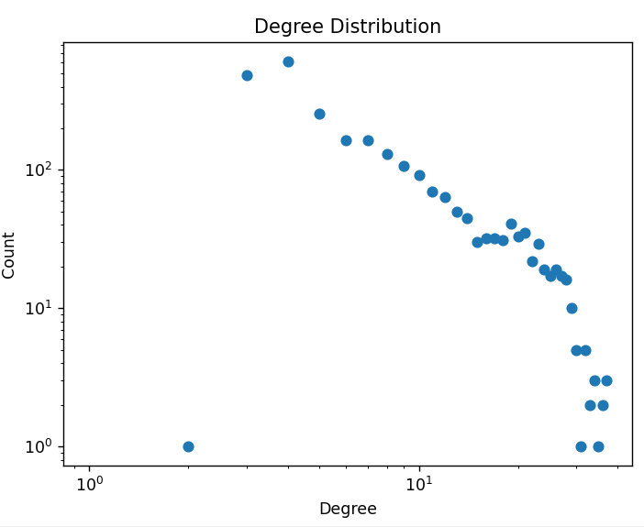
Results - Both Increase

Slide 37
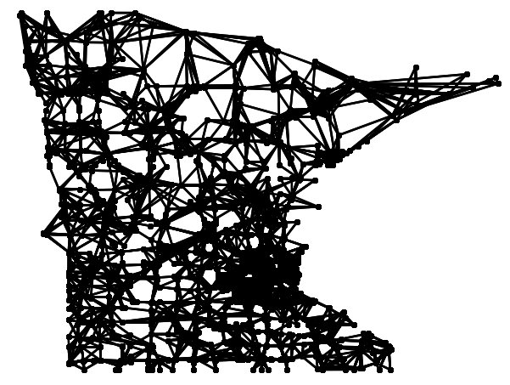
Results - Both Increase

Slide 38
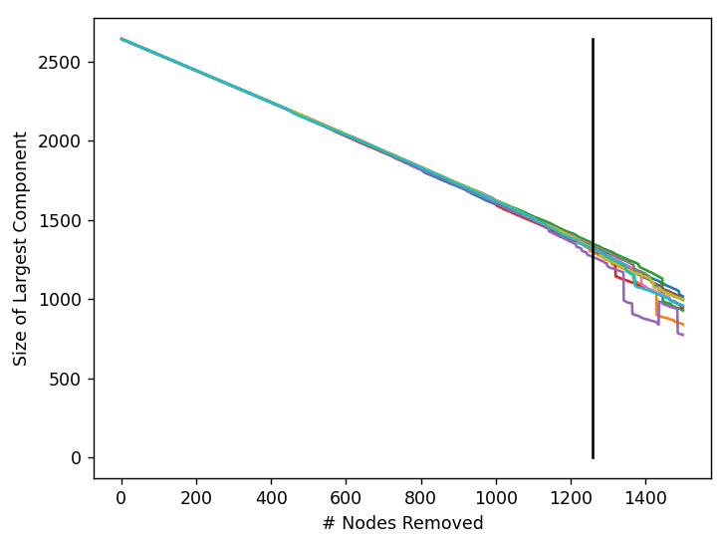
Results - Both Increase
Final H of ~ 0.794
Final density of ~8.240
Average of 1258.0 nodes

Slide 39
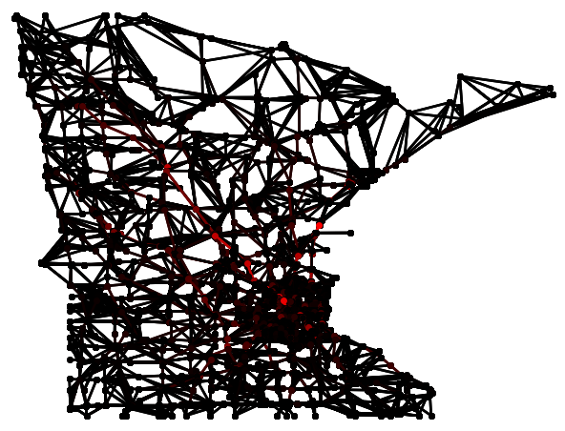
Results - Metrics for Density Increase
 |  | Old
Average Congestion | 17,286 ~0.50% | 112,576 ~3.23%
Max Congestion | 627,554 ~18.02% | 948,438 ~27.23%
Car Flow | 74,555 | 51,626
Diameter | 862 | 902
Average Distance | 240 | 253

Slide 40
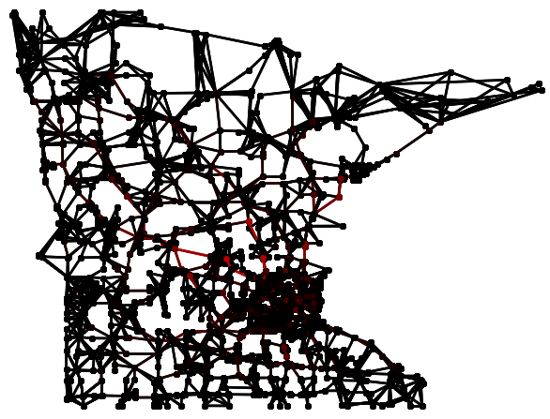
Results - Metrics for Heterogeneity Increase
 |  | Old
Average Congestion | 15,430 ~0.44% | 112,576 ~3.23%
Max Congestion | 802,194 ~23.03% | 948,438 ~27.23%
Car Flow | 94,451 | 51,626
Diameter | 893 | 902
Average Distance | 253 | 253

Slide 41
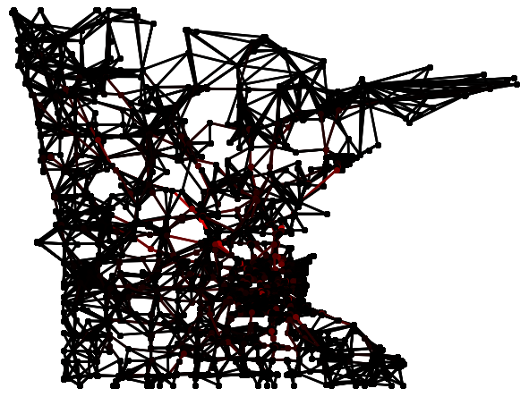
Results - Metrics for Both Increase
 |  | Best
Average Congestion | 9,708 ~0.28% | 15,430 ~0.44% (H)
Max Congestion | 583,177 ~16.74% | 627,554 ~18.02% (D)
Car Flow | 101,334 | 94,451 (H)
Diameter | 866 | 862 (D)
Average Distance | 240 | 240 (D)

Slide 42
Conclusions - Reproduction
Successfully reproduced the results of the paper
Resilience increased as density and heterogeneity increased
Maximum resilience was reached with high density and high heterogeneity

Slide 43
Conclusions
Improving the resilience of the road network has improved the performance!
Average Congestion lowered by over 10x
Car flow almost doubled
At the same time, diameter and average path length reduced

Slide 44
Future Work - Limitations
Small sample size
Undirected
Road performance measures

Slide 45
Future Work - Extensions
Limitation addressing
Optimization
Opposite Direction

Slide 46
Thank you for your attention
Questions?

Slide 47
Citations
Gao, Jianxi & Barzel, Baruch & Barabasi, Albert-Laszlo. (2016). Universal resilience patterns in complex networks. Nature. 530. 307-312. 10.1038/nature16948.
Gleich, David. (2014). Minnesota road network. Stanford. https://www.cise.ufl.edu/research/sparse/matrices/Gleich/minnesota

